Slide 1

CS-M151B
Computer Systems Architecture
Blaise Tine
UCLA Computer Science

Slide 2

Attendance

Slide 3
Agenda
High-Level-Synthesis
Roofline Model
Power

Slide 4
High-Level Synthesis (HLS)
▸ What
Automated design process that transforms a high- level functional specification to optimized register-transfer level (RTL) descriptions for efficient hardware implementation
▸ Why
Productivity
lower design complexity and faster simulation speed
Portability
single source -> multiple implementations
Permutability
rapid design space exploration -> higher quality of result (QoR)
2
©Zhiru Zhang (Cornell)

Slide 5
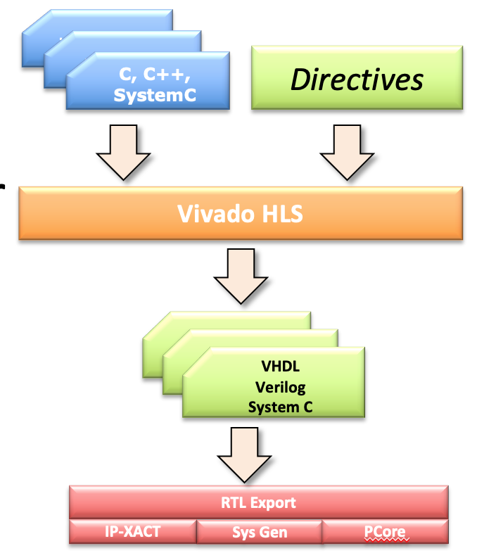
High-Level Synthesis
Compiles High-Level code to RTL
- input C/C++, output RTL
Lower HW entrance barrier
Alleviates design costs
Source: FPGA HLS tutorial, ISCA 2015

Slide 6
Typical C/C++ Synthesizable Subset
▸ Data types:
Primitive types: (u)char, (u)short , (u)int, (u)long, float, double
Arbitrary precision integer or fixed-point types
Composite types: array, struct, class
Templated types: template<>
Statically determinable pointers
▸ No support for dynamic memory allocations
▸ No support for recursive function calls
©Zhiru Zhang (Cornell)

Slide 7
Hardware Specialization with HLS
▸ Data type specialization
arbitrary-precision fixed-point, custom floating-point
▸ Communication/interface specialization
streaming, memory-mapped I/O, etc.
▸ Memory specialization
array partitioning, data reuse, etc.
▸ Compute specialization
unrolling (ILP/DLP), pipelining (ILP/DLP/TLP), dataflow (TLP), multithreading (DLP/TLP)
ILP/DLP/TLP: Instruction-/Data-/Task-level parallelism
4
©Zhiru Zhang (Cornell)
Notes:
ILP: concurrent instructions (ooo, superscalar)
DLP: concurrent memory accesses (SIMD)
TLP: concurrent tasks (multithreading)

Slide 8




















Typical C/C++ Constructs to RTL Mapping
C Constructs |  | HW Components
Functions | ➔ | Modules
Arguments | ➔ | Input/output ports
Operators | ➔ | Functional units
Scalars
➔
Wires or registers
Arrays
➔
Memories
Control flows
➔
Control logics
©Zhiru Zhang (Cornell)

Slide 9













Function Hierarchy
▸ Each function is usually translated into an RTL module
– Functions may be inlined to dissolve their hierarchy
Source code
RTL hierarchy
void A() { .. body A .. }
void C() { .. body C .. } void B() {
C();
}
void TOP( ) {
A(…);
B(…);
}
TOP
A
B
C
©Zhiru Zhang (Cornell)

Slide 10












Function Arguments
▸ Function arguments become ports on the RTL blocks
TOP
void TOP(int* in1, int* in2, int* out1)
{
*out1 = *in1 + *in2;
}
in1 in2
in1_vld in2_vld
Datapath
out1
FSM
out1_vld
Additional control ports are added to the design
▸ Input/output (I/O) protocols
– Allow RTL blocks to automatically synchronize data exchange
©Zhiru Zhang (Cornell)

Slide 11






















Expressions
▸ HLS generates datapath circuits mostly from expressions
– Timing constraints influence the degree of registering
A
char A, B, C, D, int P;
P = (A+B)*C+D
+
B
×
C
+
P
D
©Zhiru Zhang (Cornell)

Slide 12


















Arrays
▸ By default, an array in C code is typically implemented by a memory block in the RTL
– Read & write array -> RAM
- Constant array -> ROM
void TOP(int)
{
int A[N];
for (i = 0; i < N; i++) A[i+x] = A[i] + i;
}
A[N]
TOP
N-1
N-2
…
1
0
RAM
DIN DOUT
ADDR
CE WE
A_in
A_out
▸ An array can be partitioned and map to multiple RAMs
▸ Multiples arrays can be merged and map to one RAM
▸ An array can be partitioned into individual elements and map to registers
©Zhiru Zhang (Cornell)

Slide 13




















Loops
▸ By default, loops are rolled
Each loop iteration corresponds to a “sequence” of states
This state sequence will be repeated multiple times based on the loop trip count
void TOP (…) {
...
for (i = 0; i < N; i++) b += a[i];
}
TOP
S₁
+
b
LD
a[i]
S₂
©Zhiru Zhang (Cornell)

Slide 14
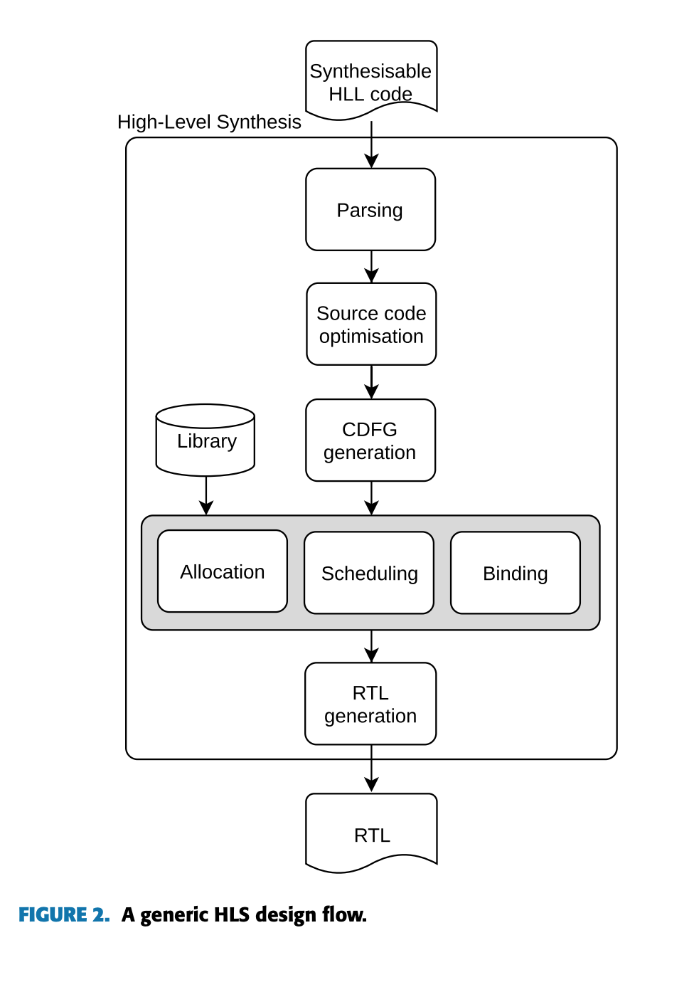
HLS Design Flow
Scheduling: Determines which operations occur during each clock cycle based on
Length of the clock cycle or clock frequency
Time it takes for the operation to completes as defined by the target device
User-specified optimization directives
Binding: Maps operations onto instantiated hardware
From: Towards automatic high-level code deployment on reconfigurable platforms: A survey of high-level synthesis tools and toolchains ,from : https://www.so-logic.net/documents/upload/Basic_HLS_Tutorial.pdf
Notes:
CDFG =-> Control/data flow graph

Slide 15
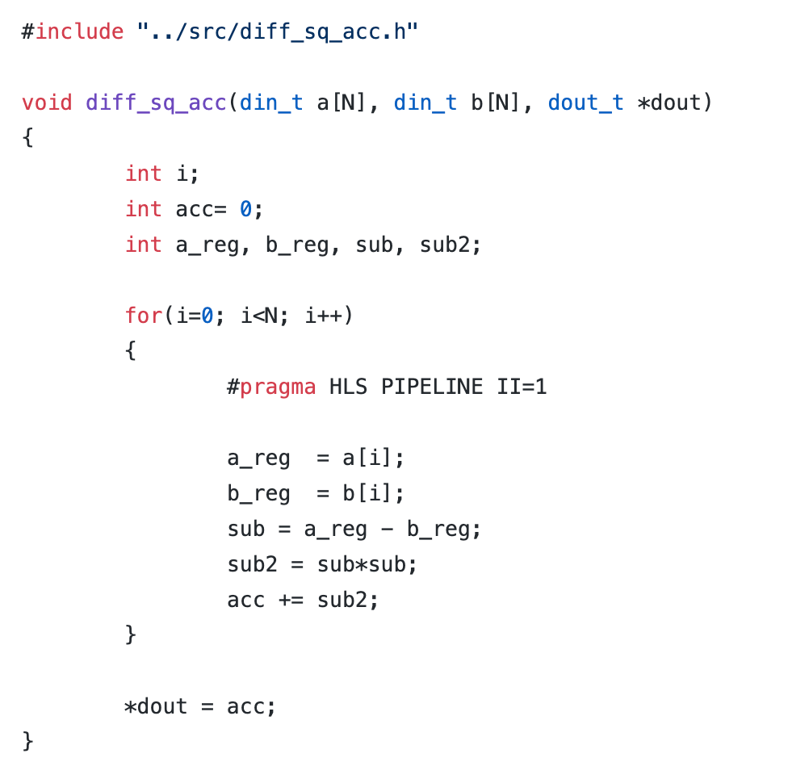
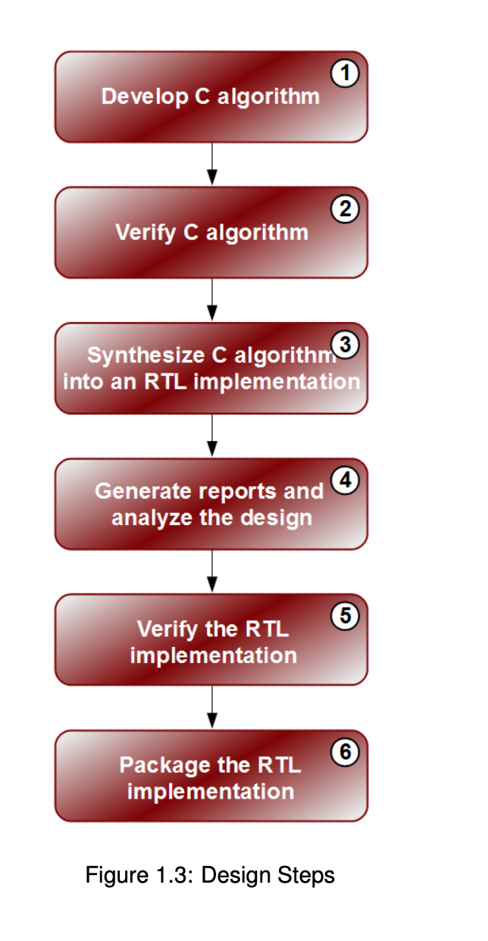
Design Steps
https://github.com/Xilinx/HLx_Examples/blob/master/Math/squared_difference_accumulate/src/diff_sq_acc.cpp
From: https://www.so-logic.net/documents/upload/Basic_HLS_Tutorial.pdf

Slide 16
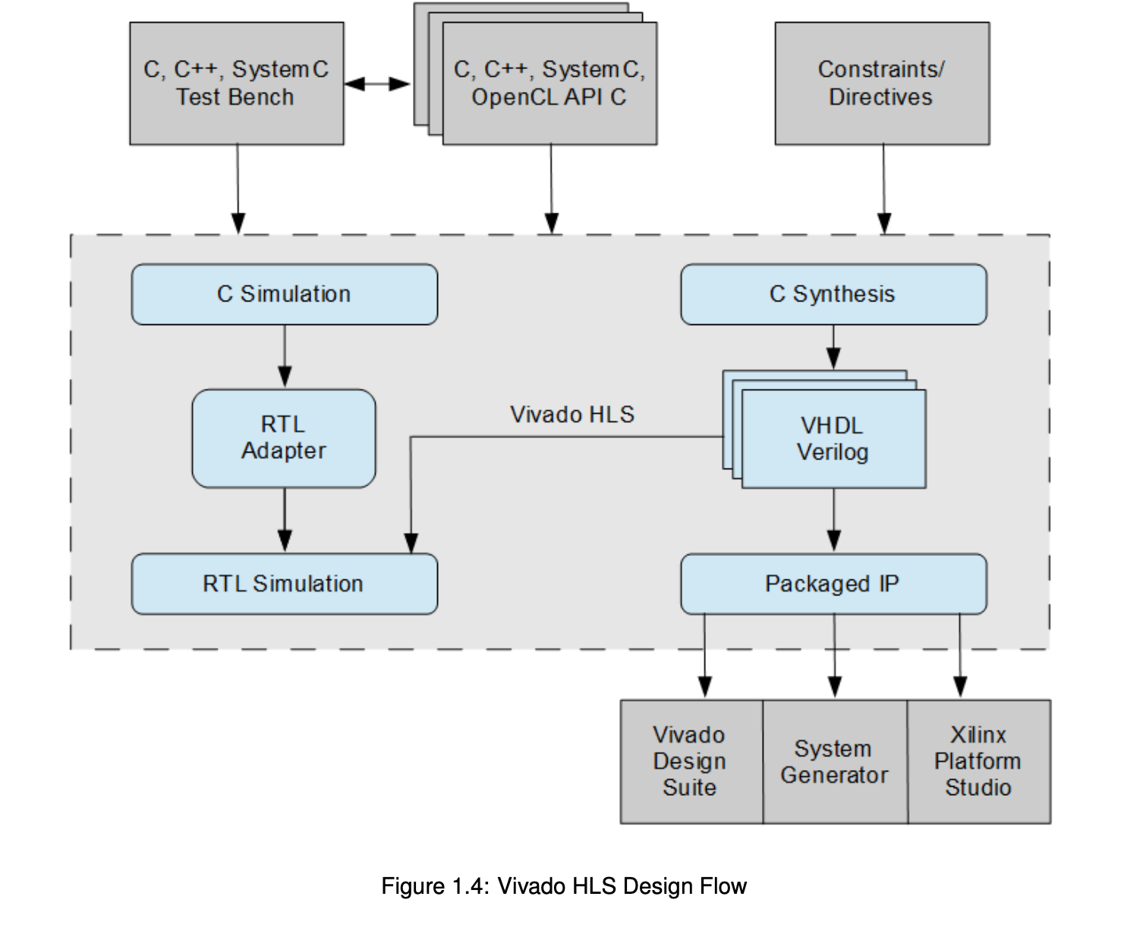
Vivado HLS Design Flow
Inputs:
C function written in C/C++/SystemC, OpenCL API
Constrains
Directives (optional)
C test bench
Outputs:
RTL implementation files (verilog or VHDL)
Report files
From: https://www.so-logic.net/documents/upload/Basic_HLS_Tutorial.pdf

Slide 17
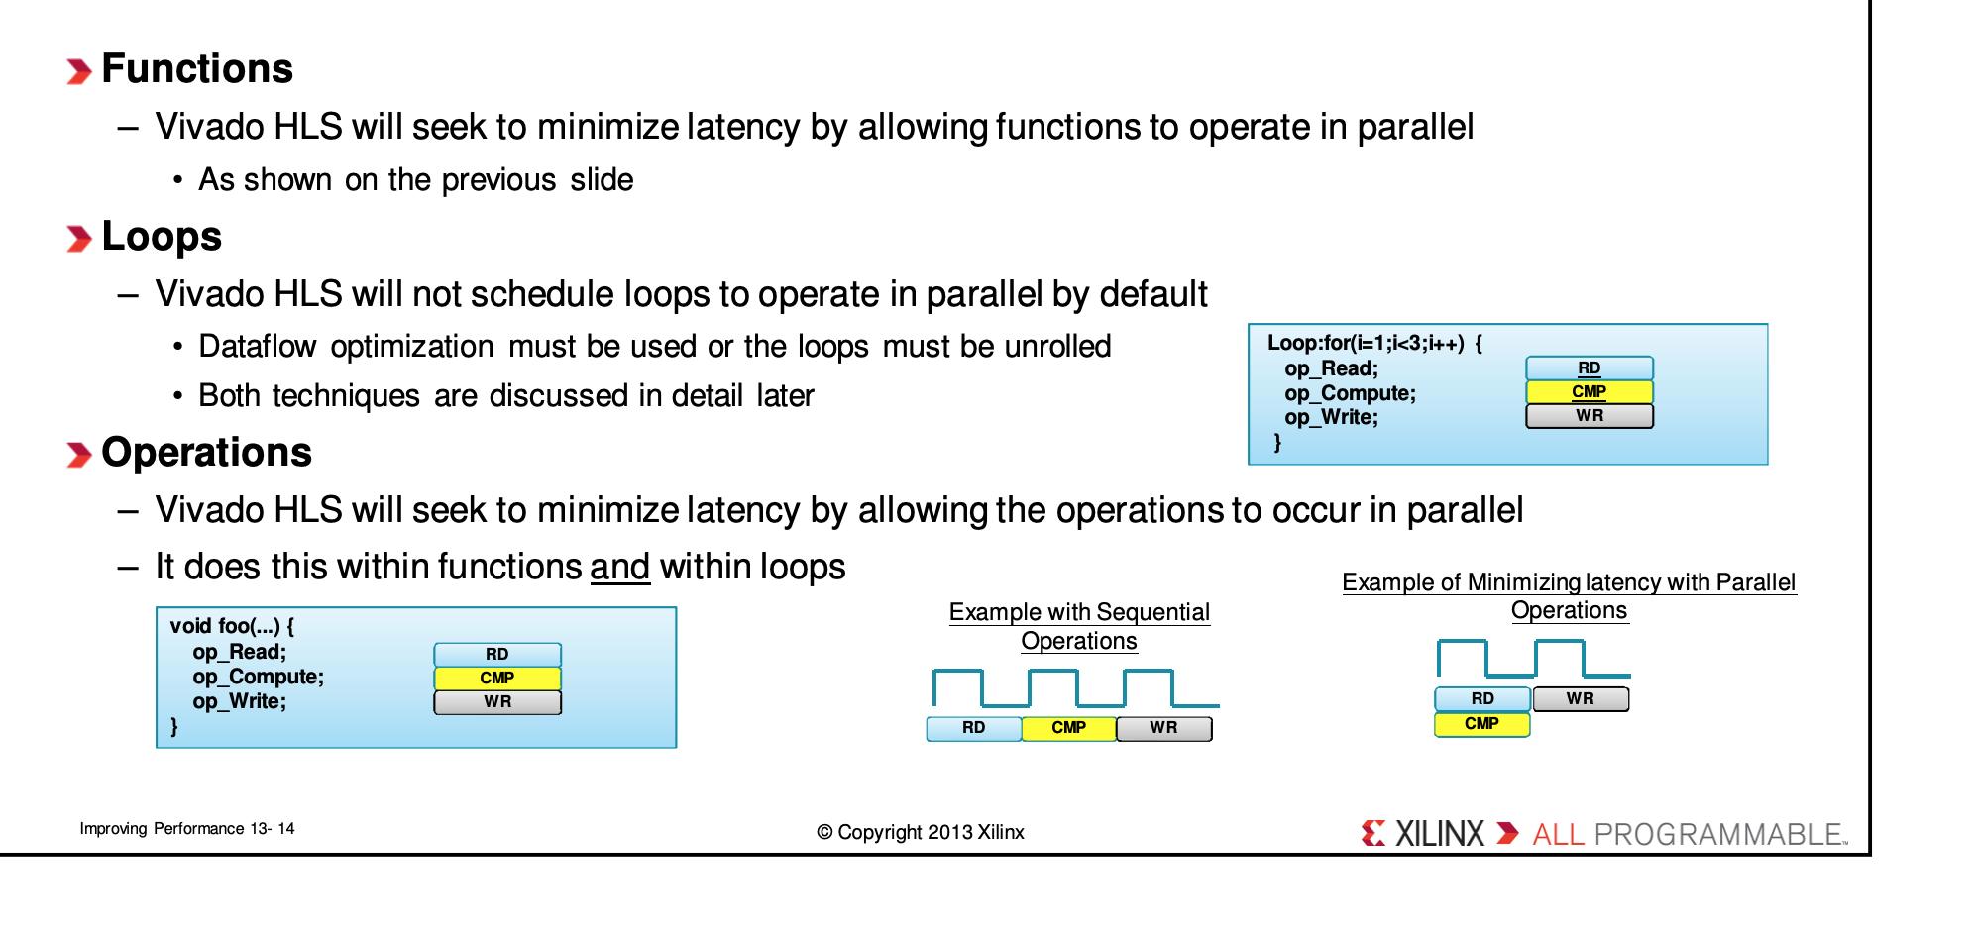
Vivado Optimizations

Slide 18
Optimizing HLS Designs
Directives guide HLS optimizations
Loop unrolling
Loop pipelining
Memory partitioning
Resource allocation and implementation
~30 unique directives
User can provide as much detail as desired
Can achieve performance on order of handwritten RTL
Source: FPGA HLS tutorial, ISCA 2015

Slide 19
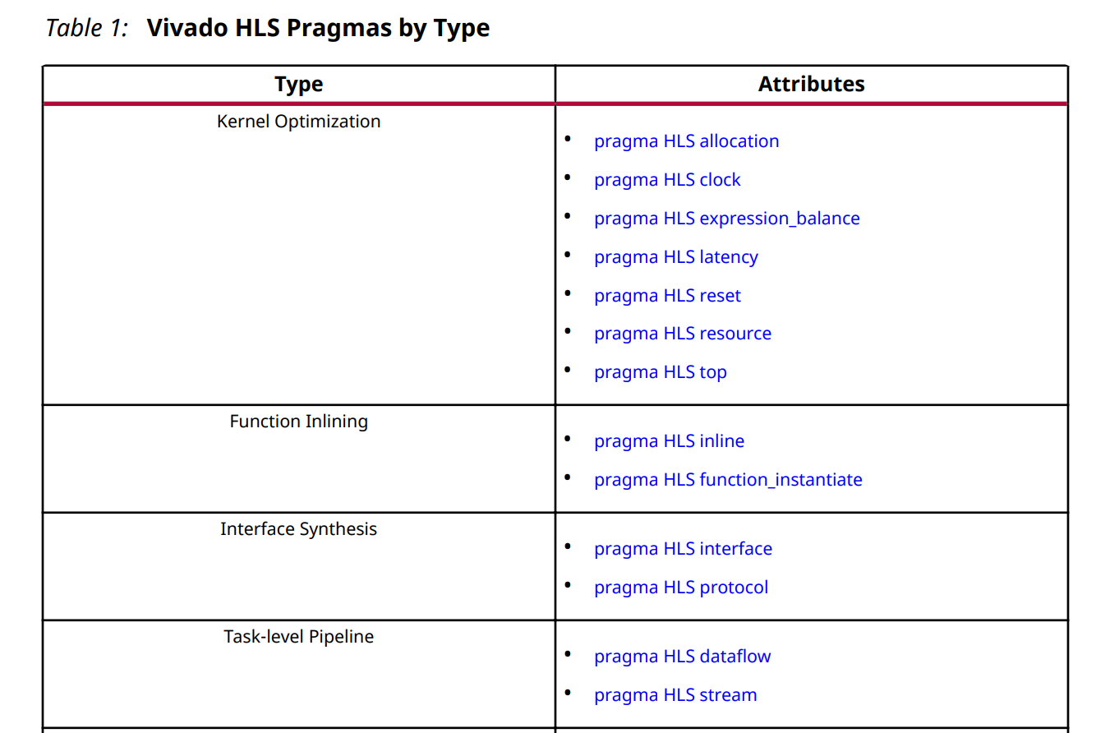
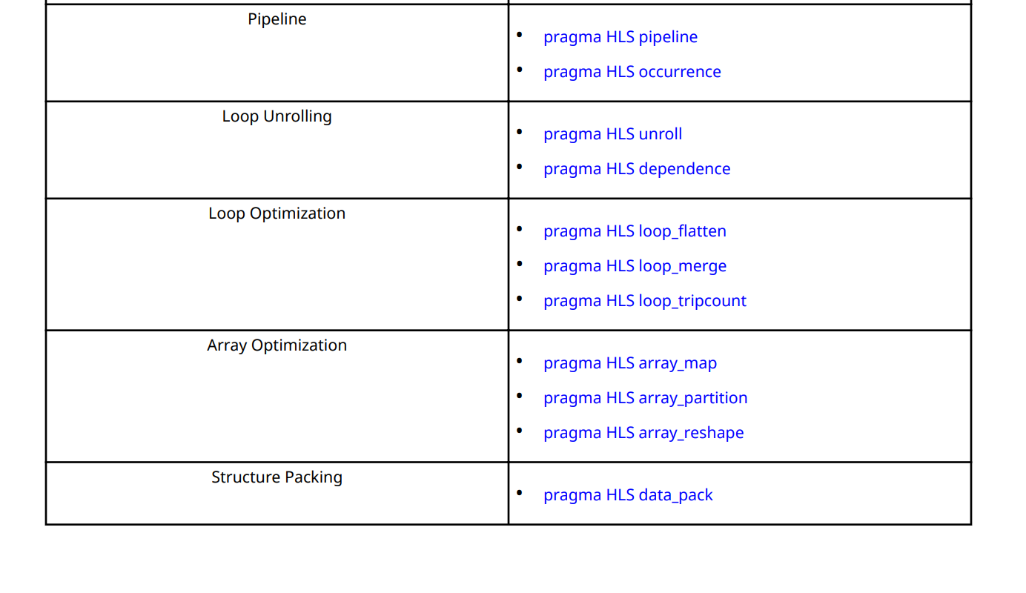
Pragmas
From: vivado HLs Optimization methodology guide
Notes:
+ hls::allocation => limit number of instances of a function (area)
+ hls::clock => specify target clock
+ hls::reset => async | sync reset
+ hls::lartency =>min/max latency of a function in cycles
+ hls:;resource => specify which type of memory to use (e.g. sram|bram)
+ hls::expression_balance => specify a balance area/perf
+ hls::top =>specify top module + hls::function_instantiate => no sharing + hls::interface => specifies I/O ports + hls::protocol => handshake protocol + hls::dependence => hind for false loop dependencies + hls::loop_flatten => remove nested loops + hls::data_pack => packed vs aligned structs elements + hls::array_map => array to memory mapping (e.g. #banks) + hls::array_partition => break array into partitions + hls::array_reshape => change array layout

Slide 20
Optimization-I : Loop Unrolling
By default, loops are rolled
Each C loop iteration
Implemented with same resources
Implemented in the same state
Use loop counter for iteration and resource access
foo_top
void foo_top (…)
for(i=3;i>=0;i--)
b = a[i] + b;
Standard HLS
+
b
a[N]
Source: FPGA HLS tutorial, ISCA 2015

Slide 21
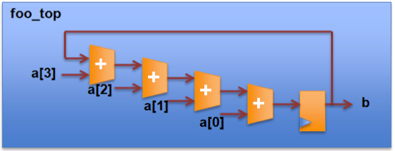
Optimization-I : Loop Unrolling
Exploits loop iteration parallelism
Instantiate resources for simultaneous execution
Respects iteration dependencies
Standard HLS
HLS & Unrolling
foo_top
+
b
a[N]
Takes 4 Cycles
Takes 1 Cycles
Source: FPGA HLS tutorial, ISCA 2015

Slide 22
Optimization II: Loop pipelining
Without Pipelining
With Pipelining
Loop_tag : for( II = 1 ; II < 3 ; II++ ) {
op_Read;
op_Compute;
op_Write;
}
RD
CMP
WR
RD
CMP
WR
RD
CMP
WR
RD
CMP
WR
RD
CMP
WR
Throughput = 3 cycles
Throughput = 1 cycle
Latency = 3 cycles
Latency = 3 cycles
Loop Latency = 6 cycles
Loop Latency = 4 cycles
Source: FPGA HLS tutorial, ISCA 2015
Notes:
Throughput ~= IPC base on one iteration of the loop

Slide 23
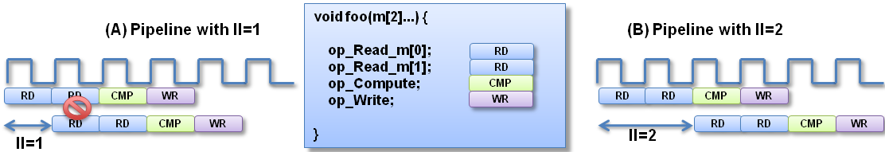
Optimization III: Loop pipelining
Iteration Interval (II)
Cycles loop must do before next iteration
II = 1 cannot always be implemented
Port cannot be read at the same time
Similar effect with other resource limitations
Source: FPGA HLS tutorial, ISCA 2015
Notes:
Iteration interval

Slide 24
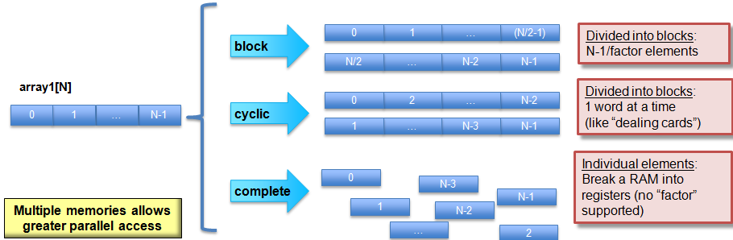
Optimization IV: Array Partitioning
Split arrays to improve memory bandwidth
Source: FPGA HLS tutorial, ISCA 2015
Notes:
Complete split use elements directly as registers Cyclic partitioning enables parallel access of consecutive entries block partitioning enables parallel access on seprate partitions

Slide 25




Permutability: Faster Design Space Exploration
Latency Area Throughput
in1 in2 in3 in4
in1 in2 in3 in4
in1 in2 in3 in4
in
+
+
1 | 2 | 3 | 4
 | 1 | 2 | 3
 |  | 1 | 2
+
+
REG
+
+
+
out1
out1
+
Control-Data Flow Graph
+
+
out1
out
t 3 *d
^{t}clk ^{≈ d}add ^{+ d}s etup f₂= 1 / (3* t_{clk} )
^{t}clk ^{d}add ^{+ d}setup
f₃ = 1/ t_{clk}
A₃ = 3* A_{add} + 6* A_{reg}
out1 = f (in1,in2,in3,in4)
clk add
f₁ = 1 / t_{clk}
A₁ = 3* A_{add}
^{A}2 ^{= A}add
2 * A_{reg}
Untimed
Combinational
Sequential
Pipelined
3
©Zhiru Zhang (Cornell)

Slide 26
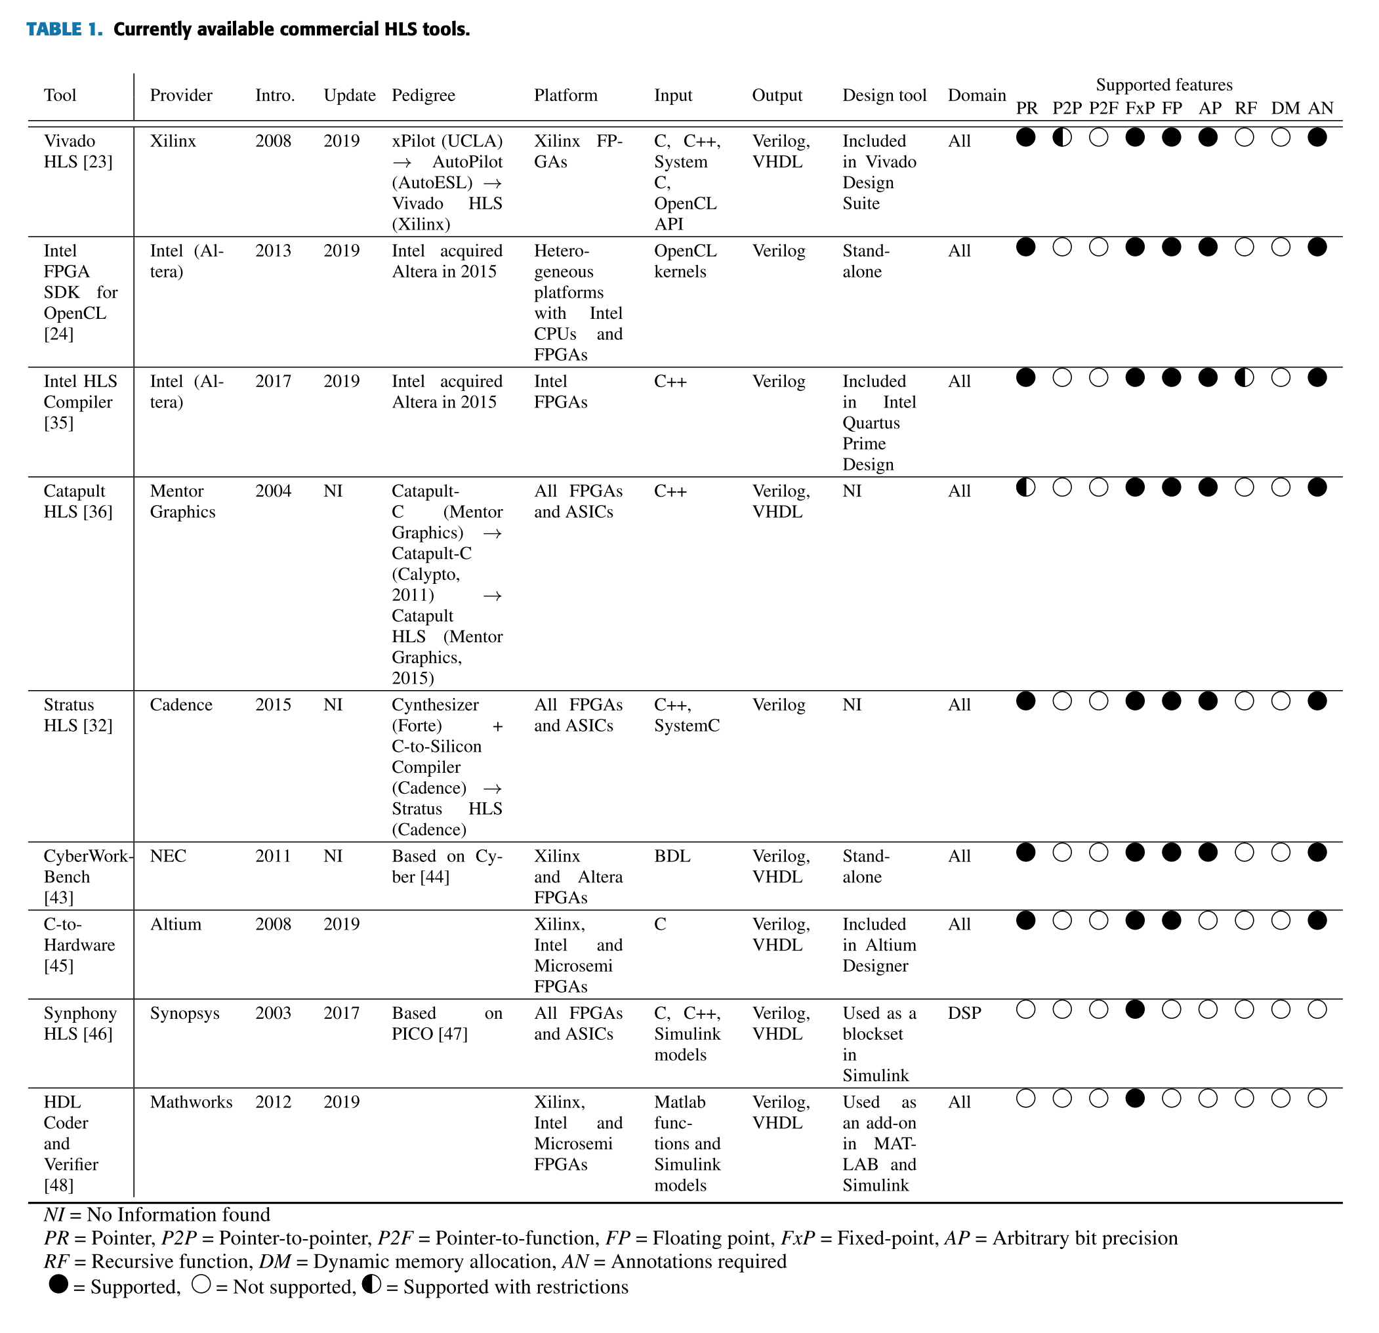
Other HLS
From: Towards automatic high-level code deployment on reconfigurable platforms: A survey of high-level synthesis tools and toolchains

Slide 27
Roofline

Slide 28
Roofline Model
Goal: Estimating the performance of your accelerator given its application domain.
How should your hardware be optimized to improve the performance of a given application?
Analogy: the 3’Cs of cache misses.
Application
Memory
Processing
Elements
©Zhiru Zhang (Cornell)

Slide 29
Roofline Model
A simplified model of a processor
Compute Bandwidth: ops / sec
Memory Bandwidth: bytes / sec
A simplified model for a program
Operations and data: ops / bytes
Also known as Arithmetic Intensity (I)
Application
Memory
Processing
Elements
©Zhiru Zhang (Cornell)

Slide 30
Roofline Model
System peak performance (P)
Maximum computational performance the system can achieve
Correlated to CPU fmax
Example: P = 100 GFlops
Application
Memory
Processing
Elements
©Zhiru Zhang (Cornell)
Notes:
Log scale makes it easier to extrapolate performance along Moore’s Law (e.g. 2x scale)

Slide 31
Roofline Model
System memory bandwidth (B)
Maximum memory (Rd/Wr) transfer speed the system can achieve
Correlated to DRAM b/w
Example: B= 25 GB/s
Application
Memory
Processing
Elements
©Zhiru Zhang (Cornell)
Notes:
Log scale makes it easier to extrapolate performance along Moore’s Law (e.g. 2x scale)

Slide 32
Roofline Model
Operational Intensity (I)
Measure how many operations are performed foe each byte of data transferred from memory
Ratio of the total number of operations to the total amount of data movement (operations per byte)
Application
Memory
Processing
Elements
©Zhiru Zhang (Cornell)
Notes:
Log scale makes it easier to extrapolate performance along Moore’s Law (e.g. 2x scale)

Slide 33
Roofline Model
Attainable Performance
The actual performance that can be achieved for a given workload
Attainable op/s = min(I * B, P)
Axis in log scale
Memory/compute-bound?
Attainable op/s
Peak op/s
Attainable op/s
Memory Bandwidth byte/s
Memory-bound
Compute-bound
Operational Intensity (op/byte)
©Zhiru Zhang (Cornell)
Notes:
Log scale makes it easier to extrapolate performance along Moore’s Law (e.g. 2x scale)

Slide 34
Roofline Model
Consider 32-bit VMADD kernel
Foreach(i): c[i] += a[i] * b[i]
Operational Intensity=?
©Zhiru Zhang (Cornell)

Slide 35
Roofline Model
32-bit VMADD kernel
Foreach(i): c[i] += a[i] * b[i]
2 flops (+, *) and 12 bytes (a, b, c)
I = 2 flops / 12 bytes = 1/6 flop/b
Consider Machine
P = 2 Gflop/s
B = 10 Gbyte/s
Attainable Performance =?
©Zhiru Zhang (Cornell)

Slide 36
Roofline Model
Consider Machine
P = 2 Gflop/s
B = 10 Gbyte/s
I = 1/6 flops/b
Attainable Performance
= min(I x B, P) = min(1.6, 2)
= 1.6 Gflop/s
Memory/compute bound?
What should we optimize?
4
2
Peak op/s
Attainable!
1
1/2
Memory Bandwidth byte/s
Attainable op/s
1/4
Memory-bound
Compute-bound
1/6
1
Operational Intensity (op/byte)
©Zhiru Zhang (Cornell)

Slide 37
Power

Slide 38
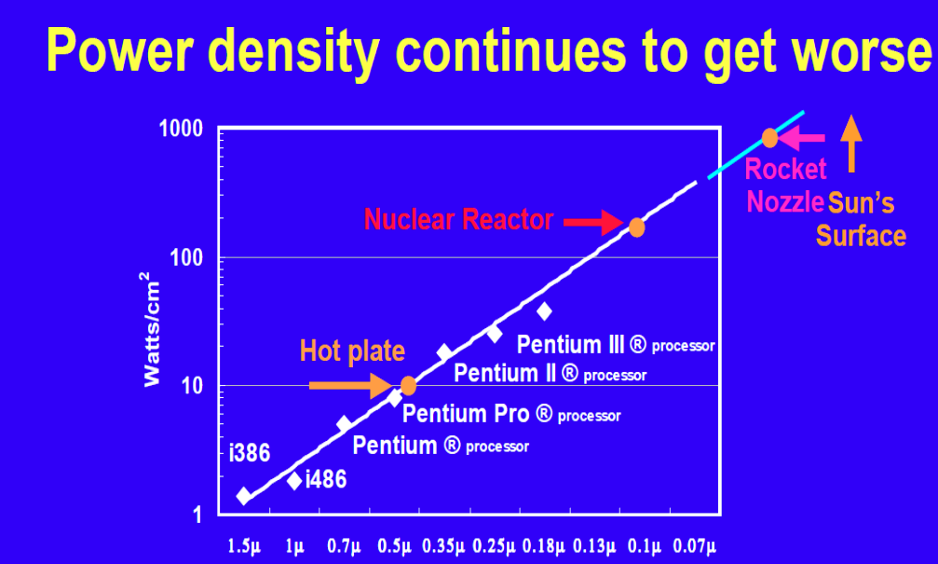
Why power?
Increasing CPU cores count => more power
Difficult to supply and cool
Wattch (Brooks et al. ‘00)

Slide 39
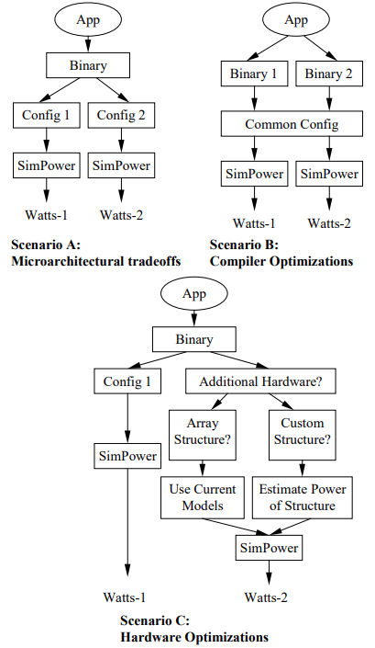
Power Modeling Techniques
Why do we do power modeling?
Microarchitectural tradeoff
Compiler optimization
Hardware optimization
Power and Performance correlation
Forecasting
Wattch (Brooks et al. ‘00)

Slide 40
Power Dissipation in CMOS
α
V dd
V dd
V_{in}
V _{out}
0
Vcc
C_{L}
I _{leakage}
Static
Dynamic
Notes:
CMOS = Complementary Metal Oxide Semiconductor
Above diagram is a CMOS inverter that is made of a PMOS(vdd) and NMOS(grnd) transistors.
Capacitor stores energy and is used to hold voltage stable for some time when it goes low. The leackage current is a small current flowing into the transistor when it is switched off

Slide 41
Power in FPGA
Static power(PSTATIC): independent of user clocks
Leakage power from all FPGA functional blocks except for I/O
Transistor junction temperature, selected device, and power characteristics (process technology)
Dynamic power
Dependent on activity factor
I/O power
DC bias power and transceiver DC bias power, which are accounted for in the I/O and transceiver sections.
Notes:
transistor junctions are the two diodes that make up the transitor (e.g. PN or NP). Transceiver = transmitter/receiver module
Activity factor [0..1] = fraction of time the transistors in the circuit are switching

Slide 42
FPGA Power estimation
FPGA tool chain provide power estimation
Quartus (Power Analyzer)
Design guide:
Earlier power estimation (process of design)
Power analyzer (uses VCD trace)

Slide 43
Power Modeling Techniques
Estimate circuit related parameters & access patterns
Simulation based modeling
Hardware performance counter-based modeling
Circuit simulation-based power modeling
e.g. cacti
Analytical based modeling

Slide 44
Power Modeling
Static Power
Area,
Circuit technology
Design parameters
Operating Voltage
Dynamic Power
Access patterns,
Frequency

Slide 45
Analytical Power Models
Wattch: Processor
Cacti: Cache, memory
Orion: NoC
McPAT: Processor
DRAM Power

Slide 46
Low-Power Optimization Techniques
Clock gating
Power gating
Dynamic voltage and frequency scaling (DVFS)
Multiple voltage islands(MVI)

Slide 47
Clock Gating
data
Sequential
Circuit
data
Sequential
Circuit
gclk
clk
clk
clk gate signal
Reduce dynamic events
Reducing the activity factor
Prune clock tree

Slide 48
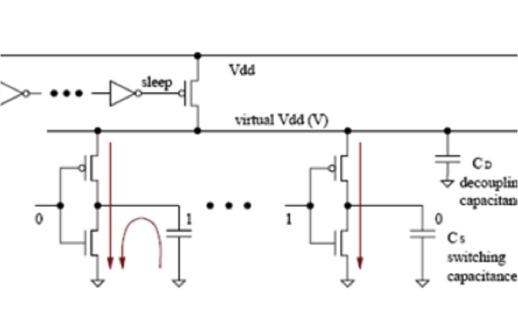
Basics of Power Gating
‘Sleep’ signal is applied when the logic detects sufficiently long idle period
Switch off Vdd
from: Microarchitectural Techniques for Power Gating of Execution Units. Hu et al.’04

Slide 49
Power Gating
Sleep
wake
Sleep
wake
Sleep
wake
Sleep
wake
D
D
D
L
L
L
L
L
L
L
L
Power gating
Sleep
wake
Sleep
wake
D
D
L
L
L
L
realistic power gating
Notes:
D=dynamic power
L=leakage/static power changes linearly

Slide 50
Power Gating
When to power-gate?
Power gating policies:
Idle Policy
Shut the unit after use if future idle period > break even point
Assumes perfect knowledge of the future when the component will go idle
Flag policy
Shut the unit when idle counter reaches a threshold
Immediate policy
Shut the unit immediately after use
Notes:
Break even point may vary depending on the application

Slide 51
Power Gating
Power reduction policies
Branch mispredictions
L2 misses
Lock contentions
TLB misses
Early thread terminations
I-cache with trace cache or loop buffer
Notes:
The processor will be waiting on those events to resolved, no need for it to run at full power.

Slide 52
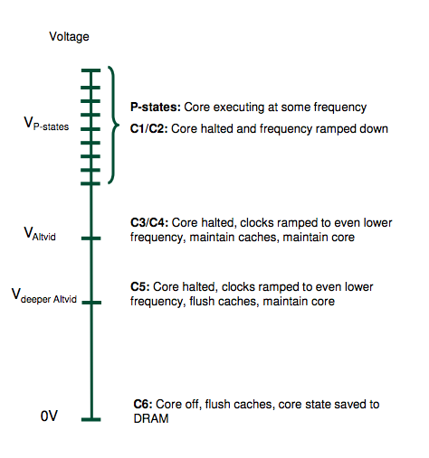
Intel’s Power Management States
Power management states
C states, P states
C states: idle states
P states: power saving states
AMD Hotchip23 presentation

Slide 53
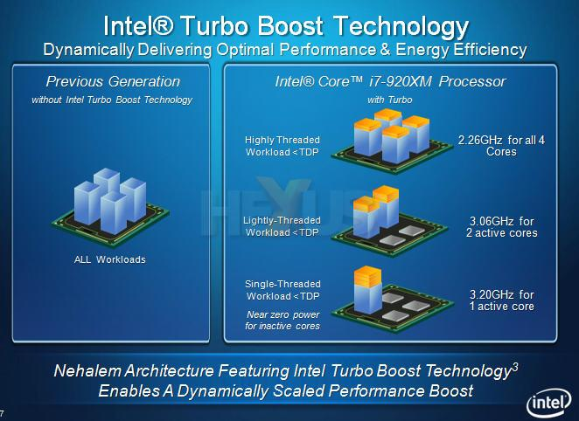
Intel Turbo Boost Technology

Slide 54
Q&A

Slide 55
References
https://www.xilinx.com/html_docs/xilinx2020_1/vitis_doc/programmingvitishls.html#tlb1539734222626
https://www.xilinx.com/html_docs/xilinx2020_1/vitis_doc/programmingvitishls.html#tlb1539734222626
Vitis High-Level Synthesis User Guide : https://www.xilinx.com/support/documentation/sw_manuals/xilinx2021_1/ug1399-vitis-hls.pdf
AXI DMA v 7.1 https://www.xilinx.com/support/documentation/ip_documentation/axi_dma/v7_1/pg021_axi_dma.pdf

Slide 56
Acknowledgement
This course is partly inspired and use materials from the following courses created by my colleagues:
ECE-M1126C: Nader Sehatbakhsh @ UCLA
CS3220: Hyesoon Kim @ gatech

